Slide 1

GPS Tracker

Slide 2

Group members
Vương Minh Phú 1551112
Lê Hoàng Giang 1551032

Slide 3

Applications

Slide 4

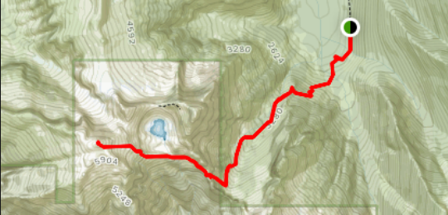
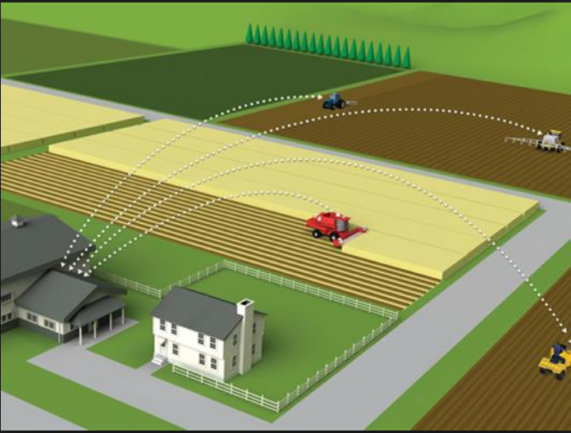
Tracker: climbing, backtracking
Security: find your phone
Farming

Slide 5
Solution

Slide 6
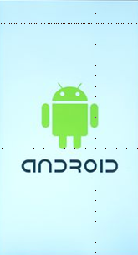

Build an Android app to take the location.
A Website to show results

Slide 7
APP ARCHITECTURE

Slide 8


BUILDING TOOLS

Slide 9
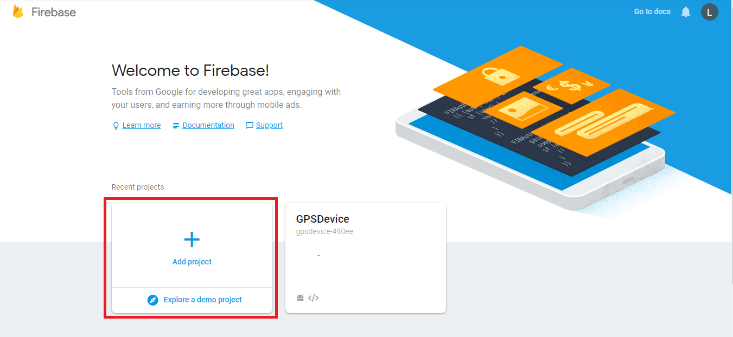
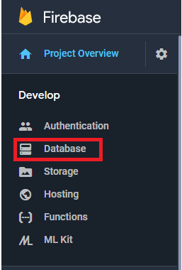
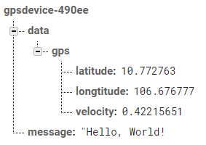
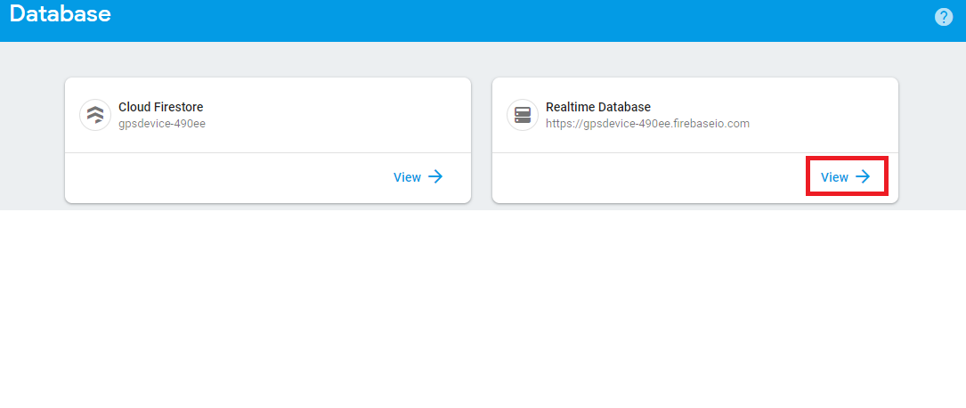
Firebase
second
second

Slide 10
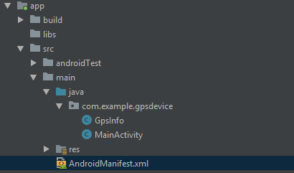
IN MANIFEST

Slide 11
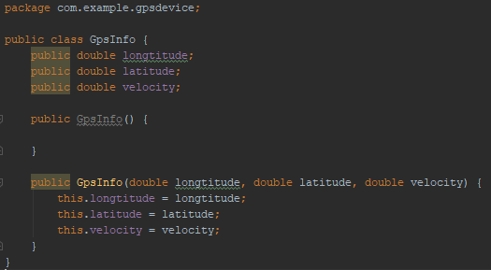
INITIAL JAVA FUNCTION

Slide 12


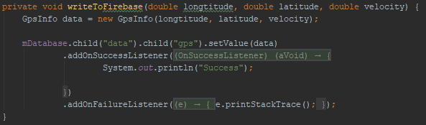
MAIN JAVA FUNCTION

Slide 13
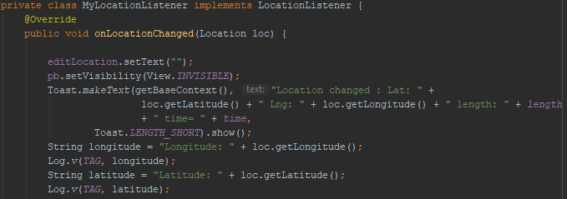

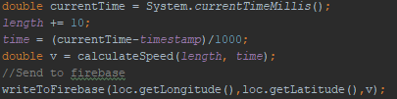
GET LOCATION

Slide 14

User Interface

Slide 15






Web design
White
Gray
Black
Black
Black

Slide 16

Web design:
Positions
Path
Estimate velocity

Slide 17

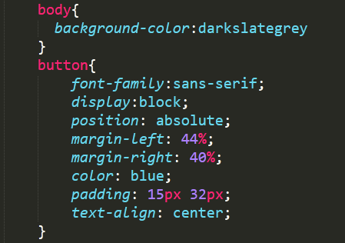
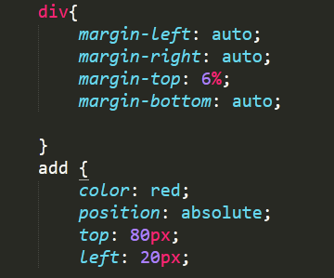
CSS

Slide 18

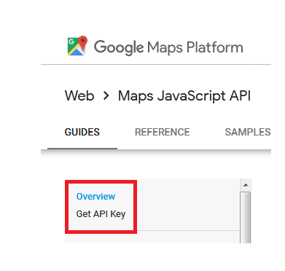
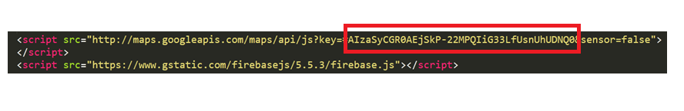
javascript
second

Slide 19
ANDROID PROJECT
Show and explain your web, app or software projects using these gadget templates.
Place your screenshot here

Slide 20
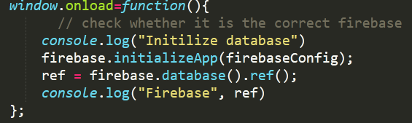
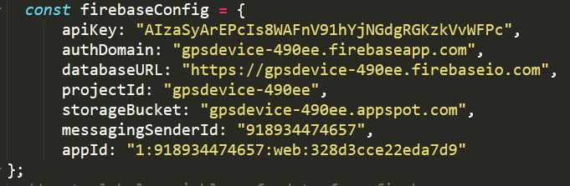
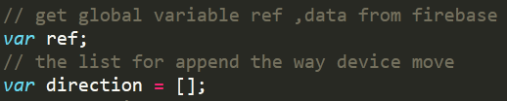

Slide 21
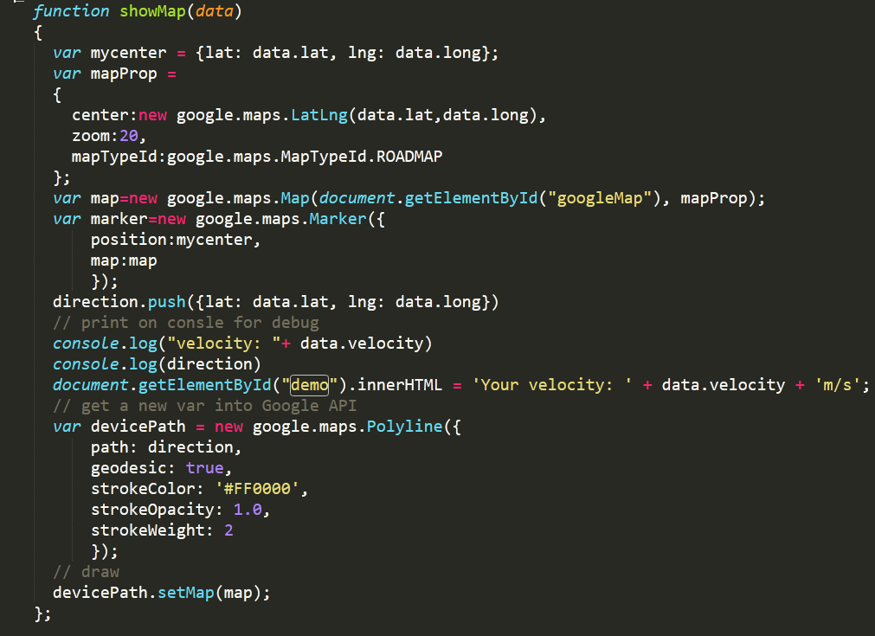
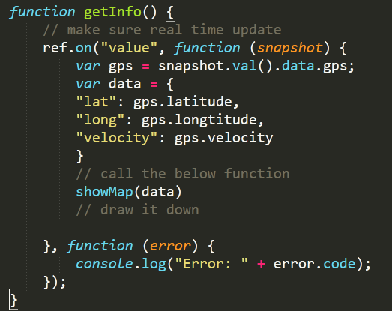

Slide 22
Thanks!
Any questions?
You can find me at:
@username
user@mail.me

Slide 23
SlidesCarnival icons are editable shapes.
This means that you can:
Resize them without losing quality.
Change line color, width and style.
Isn’t that nice? :)
Examples:

